Slide 1
Progress Meeting 03/04/2020
Notes:
Useful books for creating MATLAB solver:
Fundamentals of engineering numerical analysis – Parvis Moin
Stability and transition in shear flows – Peter Schmid

Slide 3
Progress
Went through code
Fully debugged the code
Now matches the Appendix of Schmid and Henningson
Matches results from literature (Re = 10000)
Code gives critical Re for plane Poiseuille flow at 5772 -> Correct!

Slide 4
Questions about the code
Plotting U vector does not give a straight line for pCf?
Chebyshev grid points appear not to be cosine mesh?
Am I interested in the Squire system?
Instabilities come from Orr-Somm?

Slide 5
Working On…
Deriving the Orr-Sommerfeld Eigenvalue Problem with the stratified shear flows with the inalignment
Went through Hydrodynamic Stability lecture notes derivation
Determining governing equations for stratified shear flow

Slide 6
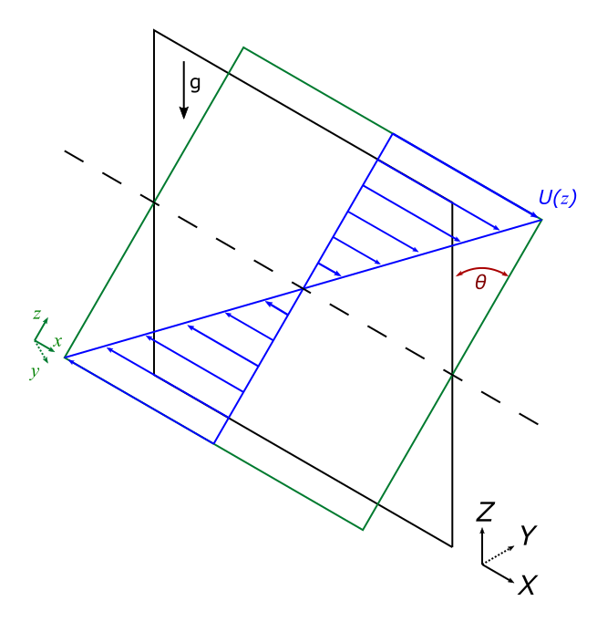
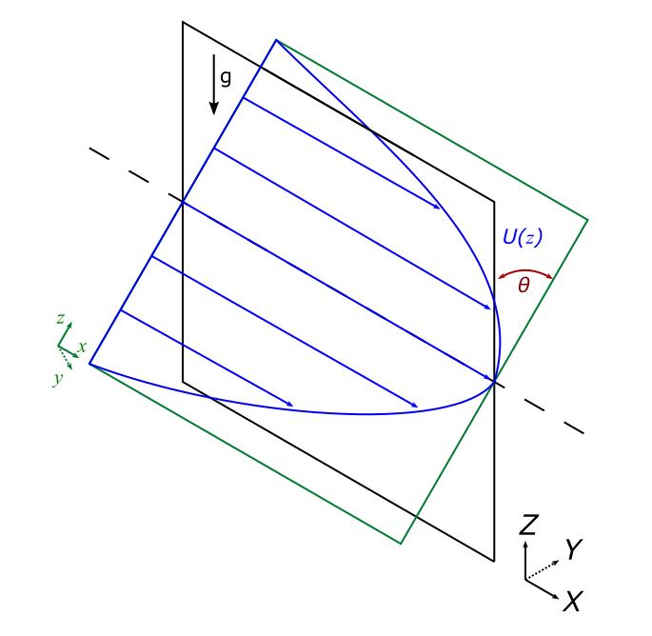
Coordinate System

Slide 7
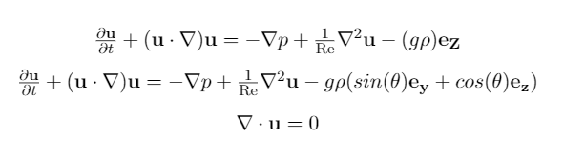
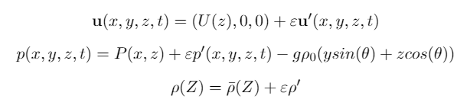
Governing Equation

Slide 8
Questions on derivation
The rho in the governing equation – is that a density perturbation or the density profile: rho(Z)?
Am I employing linear density gradient?
Do I need to non-dimensionalise the governing equations?
Where does Froude number come into the equations?

Slide 9
Plan for next week
Finish deriving stratified shear flow eigenvalue system
Linearise governing equations
Follow Orr-Somm derivation
Start implementing it into the MATLAB Solver

